Slide 1

A Horticultural Jargon Buster
Welcome
Session 1 – What's in a name?
20th February 2019

Slide 2
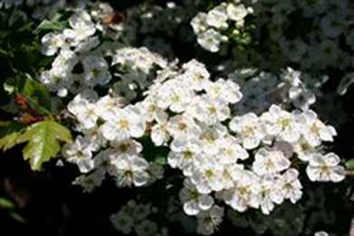
What's in a name?
Latin / Scientific names
Are they our greatest challenge with jargon?
Latin / Scientific Name
Crataegus monogyna
Common Names
English hawthorn, hawthorn, may, may thorn, Neapolitan medlar, oneseed hawthorn, one-seeded hawthorn, quickthorn, red hawthorn, single seeded hawthorn, single seed hawthorn, single-seed hawthorn, thorn-apple, whitethorn
Latin is the universal language we all work in
20th February 2019

Slide 3

What's in a name?
Genus
is a generic term used to classify more than one species of plant that are closely related in characteristics
Species
is a group of plants, smaller than a genus, that are similar and belong together, or have some shared quality
Cultivar / Variety
or ‘cultivated variety’. A cultivar is selected and cultivated; some cultivars originate as sports or mutations on plants. Other cultivars could be hybrids of two plants, propagation by seed producing something different from the parent plant
20th February 2019

Slide 4
What's in a name?
Latin / Common Name Meanings - Areas / Environments
Name |  | Meaning |  | Name | - | Meaning
Abyssinica | - | Abysinnia |  | Helvetica | - | Switzerland
Alpestris | - | From mountains |  | Japonica | - | Japan
Alpicola | - | From mountains |  | Magellanica | - | South America
Alpina | - | From Alps |  | Maritima | - | Near the sea
America | - | From America |  | Mexicana | - | Mexico
Arctica | - | From the Arctic |  | Montana | - | Mountains
Arenaria | - | From shady places |  | Palustris | - | Marshes
Arvensis Or Camperstris | - | Field |  | Pratensis | - | Field
Australis | - | From the South |  | Rivalis | - | Near river
Borealis | - | From the North |  | Rivularis | - | Near river
Bulgarica | - | Bulgaria |  | Rupestris | - | Hills
Canadensis | - | Canada |  | Rupicola | - | Hills
Canariensis | - | Canary Isle |  | Russica | - | Russia
Capensis | - | South Africa |  | Saxatilis | - | Rocks
Chilensis | - | Chile |  | Sibirica | - | Siberia
Chinensis | - | China |  | Sinense | - | China
Clivora | - | Hills |  | Sylvestris | - | Woods
Glacialis | - | Cold areas |  | Texensis | - | Texas
Graeca | - | Greece
20th February 2019

Slide 5
What's in a name?
Latin / Common Name Meanings - Colour
Name |  | Meaning |  | Name |  | Meaning
Alba | - | White |  | Luteus | - | Yellow
Ater | - | Black |  | Maculata | - | Spotted
Aurantiaca | - | Orange |  | Magenta | - | Magenta
Aurea | - | Yellow/Gold/Chartreuse |  | Nigra | - | Black/Dark
Azur | - | Blue |  | Ochroleuca | - | Cream
Caerulea | - | Blue |  | Pallida | - | Cream
Chrysantha | - | Yellow |  | Phoenicea | - | Purple
Chrysus | - | Yellow |  | Punica | - | Red
Coccinea | - | Red/Scarlet |  | Puniceus | - | Red-purple
Erythro | - | Red |  | Purpurea | - | Pink (deep)
Ferrugineus | - | Rusty |  | Purpureus | - | Purple
Flava | - | Yellow |  | Rosea | - | Pink (rose)
Haema | - | Blood red |  | Rubra | - | Red
Incana | - | Grey |  | Sanguinea | - | Red (blood)
Lacteus | - | Milky |  | Sulphurea | - | Yellow
Leuc | - | White |  | Violacea | - | Violet
Lividus | - | Blue-grey |  | Virens | - | Green
Luridus | - | Pale yellow |  | Viridis | - | Green
20th February 2019

Slide 6
What's in a name?
Latin / Common Name Meanings - Flower / Interest
Name |  | Meaning |  | Name | - | Meaning
Aestivalis | - | Flowering in spring |  | Muralis | - | Walls
Annua | - | Annual |  | Odorata | - | Perfumed
Antha | - | Flowered |  | Officinalis | - | Herbal use
Anthos | - | Flower |  | Pendula | - | Weeping
Arboricola | - | Living on trees |  | Perennis | - | Perennial
Autumnalis | - | Autumn |  | Praecox | - | Spring (early)
Densiflora | - | Densly flowered |  | Quercifolia | - | Oak leafed
Flora | - | Flower |  | Rediviva | - | Perennial
Flore Plena | - | Double flowered |  | Sativa | - | Cultivated
Florida | - | Floriferous |  | Scaber | - | Climbing
Foetida | - | Unpleasant smell |  | Scandens | - | Climbing
Hetero | - | Diverse |  | Semperviva | - | Perennial
Hyemalis | - | Winter |  | Somnifera | - | Sleep (inducing)
Inodora | - | Unscented |  | Vernalis | - | Spring
Longiflora | - | Long flowers |  | Vulgaris | - | Common
20th February 2019

Slide 7
What's in a name?
Latin / Common Name Meanings - Size / Structure (1)
Name |  | Meaning |  | Name |  | Meaning
Acaulis | - | Stemless |  | Folia | - | Leaved
Altissima | - | Tallest |  | Foliosa | - | Leafy
Angustifolia | - | Narrow leaved |  | Folius | - | Foliage
Argentea | - | Silvery |  | Fruticosa | - | Shrubby
Armata | - | Prickley |  | Gigantea | - | Giant
Barbata | - | Hairy (bearded) |  | Glabra | - | Smooth
Bellidifolia | - | Like a daisy |  | Globosa | - | Rounded
Brevi | - | Short |  | Glutinosa | - | Sticky
Bulbifera | - | Bulbus |  | Gracilis | - | Graceful
Caespitosa | - | Dense |  | Graminifolia | - | Grassy leaves
Campanulata | - | Bell Like |  | Grandi | - | Large
Compacta | - | Compact |  | Grandiflora | - | Large flowered
Contorta | - | Twisted |  | Grandis | - | Big
Decidua | - | Deciduous |  | Hirsuta | - | Hairy
Digitata | - | Hand-like leaf |  | Hispida | - | Bristly
Edulis/Esculenta | - | Edible |  | Humilis | - | Short
Farinosa | - | Powdery |  | Integrifolia | - | Undivided leaves
Ficifolia | - | Fig-like leaf |  | Laevis | - | Smooth
Fili | - | Threadlike |  | Lanata | - | Woolly
20th February 2019

Slide 8
What's in a name?
Latin / Common Name Meanings - Size / Structure (2)
Name |  | Meaning |  | Name |  | Meaning
Lepto | - | Slender |  | Multi | - | Many
Longifolia | - | Long leaves |  | Multiflora | - | Many flowered
Macrantha | - | Lare Flower |  | Nana | - | Dwarf
Macro | - | Large |  | Ovalifolia | - | Oval leaves
Macrocarpa | - | Large fruited |  | Parvi | - | Small
Macrophylla | - | Large leaves |  | Parviflora | - | Small flowered
Macrorrhiza | - | Large roots |  | Parvifolia | - | Small leaves
Magna | - | Big |  | Pauci | - | Few
Magnus | - | Large |  | Pauciflora | - | Few flowered
Majus | - | Bigger |  | Paucifolia | - | Few leaves
Maxima | - | Biggest |  | Phylla | - | Leaves
Mega | - | Big |  | Phyllos | - | Leaf/foliage
Micrantha | - | Small flowered |  | Pinnata | - | Pinnate leaves
Micro | - | Small |  | Platy | - | Flat/broad
Microphylla | - | Small leaves |  | Poly | - | Many
Millefolia | - | Many leaves |  | Polyphylla | - | Many leaves
Minima | - | Small |  | Procumbens | - | Creeping
Minor | - | Smaller |  | Prostrata | - | Creeping/prostrate
Mono | - | Single |  | Pulverulenta | - | Dusty
20th February 2019

Slide 9
What's in a name?
Latin / Common Name Meanings - Size /Structure (3)
Name |  | Meaning |  | Name |  | Meaning
Pumila | - | Small |  | Tomentosa | - | Woolly
Pygmaea | - | Small |  | Trifoliata | - | Three lobed leaves
Reptans | - | Creeping |  | Umbellata | - | Flowers in umbel
Rotundifolia | - | Round leafed |  | Velutina | - | Velvety
Spicata | - | Spiked |  | Villosa | - | Hairy
Spinosa | - | Spiny |  | Viscosa | - | Sticky
Stellata | - | Starry |  | Vitifolia | - | Vine like leaves
Tenuifolia | - | Narrow leaves |  | Volubilis | - | Twining
The preceding glossary of Latin terms is by no means definitive. We can see from the examples that we have looked at that the name can provide an insight into form, habit and flower colour, or indeed a preferred environment.
20th February 2019

Slide 10
A Horticultural Jargon Buster
Session 2 – Palmstead Plant Groups
www.palmstead.co.uk
20th February 2019

Slide 11
Palmstead Plant Groups
Aquatic : a plant that grows in water, whether rooted or floating, without anchorage in a deep water or marginal environment
Alpine : plants that grow in an alpine climate which occurs at high elevation and above the tree line. These include perennial grasses, sedges, forbs, cushion plants, mosses, and lichens
Bamboo : a woody plant with a hollow stem that's in the grass family
Bedding plant : a plant set into a garden bed or container when selection is about to bloom, typically an annual used for display
Bulb : an underground storage organ consisting of a short stem surrounded by fleshy scale leaves or leaf bases, lying dormant (we include corms, tuners and roots)
20th February 2019

Slide 12
Palmstead Plant Groups
Climbers : are plants which climb trees and other hosts using a range of adaptions such as twine stems, adapted leaf petioles, suction pads, aerial roots or barbed thorns (Wall Plants)
Conifer : a tree that bears cones and needle-like or scale- like leaves that are typically evergreen, exceptions include Larix
Herbs : have savoury or aromatic properties that are used for flavouring and garnishing food, medicinal purposes or for fragrances
Note – not all herbs are excluded (zero rated) from VAT (see VAT Notice 701/38)
Herbaceous : are plants that have non-woody stems. Their above ground growth largely or totally dies back in winter, but they have underground parts (roots, bulbs, etc.) that survive and re-grow
20th February 2019

Slide 13
Palmstead Plant Groups
Fern : a flowerless spore-producing plant with leaf-like fronds
Fruit : a generic term we apply to a group of seed-bearing plants at are edible formed from the ovary after flowering
Grasses : are monocotyledons, usually herbaceous with narrow leaves growing from the base. They include the ‘true grasses’, as well as the sedges and rushes
Hedge : a row of shrubs or small trees that are planted close to each other in order to form a boundary or something that provides protection, screening or defence
Shrub deciduous
: refers to trees or shrubs that lose their leaves seasonally
20th February 2019

Slide 14
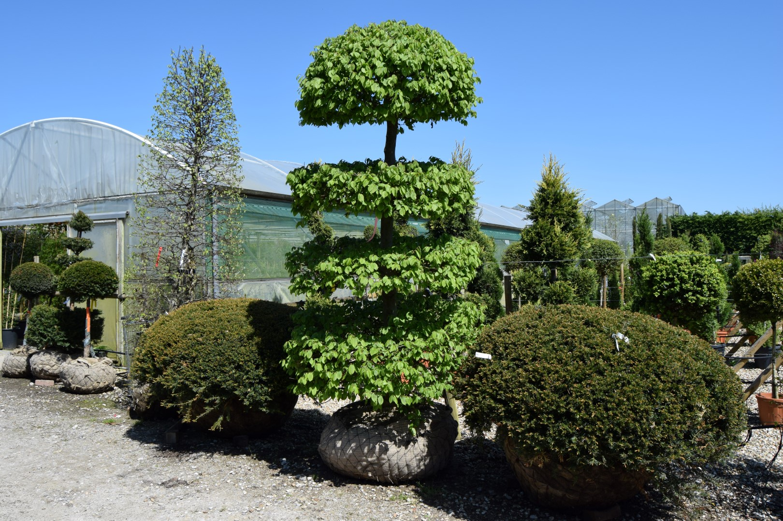
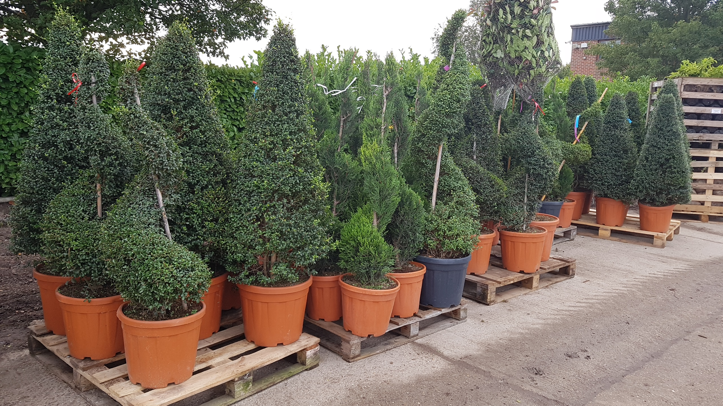
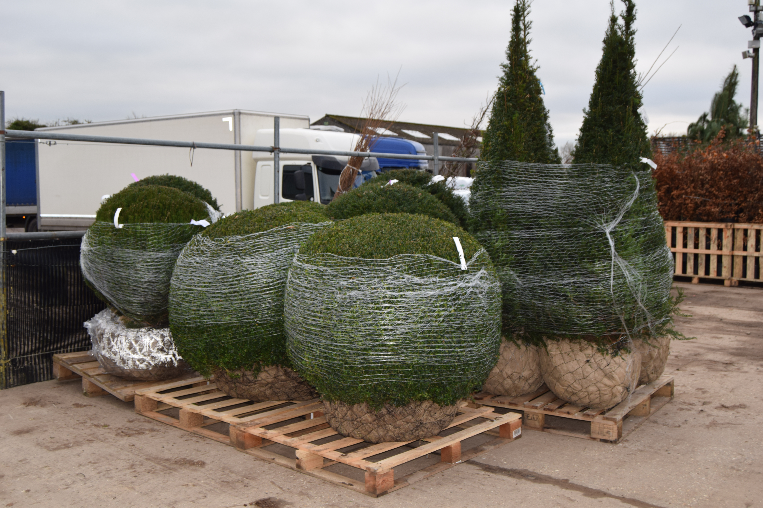
Palmstead Plant Groups
Shrub evergreen
: a plant that has leaves throughout the year, ‘always green’
Topiary : the horticultural practice of training perennial plants by clipping the foliage and twigs of trees to maintain clearly defined shapes, whether geometric or fanciful shapes
Trees : a perennial plant with an elongated stem or trunk supporting branches and leaves
A picture can speak a thousand words…
20th February 2019

Slide 15
A Horticultural Jargon Buster
Session 3 –Forms & Types
www.palmstead.co.uk
20th February 2019

Slide 16
Bulbs
Bulbs : supplied as a ‘bulbs’
          Corms & Tubers
          Corm - a rounded underground storage organ consisting of a swollen stem base covered with scale leaves
          Tuber – a thickened underground part of a stem or rhizome serving as a food reserve bearing buds from which new plants arise
          In the green
          Seasons
          Sizes – ‘Top Size’ some examples
            Crocus 10+
            Daffodils 16+ (excludes species types)
            Hyacinths 16+
            Tulips 12+ (excludes species types)
20th February 2019

Slide 17
Containers
Containers : plants that have formed a robust root system where the compost, under light pressure, holds its form
- Containerised : typically rootballed plants in containers that, if handled with care, can be planted throughout the year
- Lightly rooted : generally applied to plants that have good top growth but a light root system that, if handled with care, can be planted
- Trimmed : a term applied to plants that have been trimmed in the container and are in the process for re-flushing
20th February 2019

Slide 18
Containers - size guide
Standard Range - House & Grower Range
Standard Range
Deep (Climber Pots)
20th February 2019

Slide 19
OG & BR Hedging
Open Ground & Bare Root
: Lifted from the ground and supplied with no soil on the root system, season limited – November to March
(1+1) | Starting in the seed beds and then lined out for 1 year (plant is 2 years old)
(1u1) | Starting in the seed beds and lined out, the plant is undercut resulting in a heavier root system and straight plant (plant is 2 years old)
(1+2) | Starting in the seed beds and then lined out for 2 year making a heavier plant (plant is 3 years old)
(2+1) | A 2 year old plant lined out for a further year making for a heavier plant (plant is 3 years old)
(1+3) | A 1 year old seedling grown in seed beds and then lined out for 3 years producing a heavier plant (plant is 4 years old)
(2+2) | A 2 year old plant lined out for a 2 further years, giving a stockier, bushier plant (plant is 4 years old)
(C+2) | A plant grown in the ground for 2 years from a container/plug/root trainer
20th February 2019

Slide 20
RB – Co-co Wrap
Rootballs and Co-co Wrap
: Lifted between November – March; items are lifted complete with root system and soil, the size of the resulting rootball dependent on the size of the item
- Burlap : usually for the smaller items, a square of ‘open’ cloth tied around the base of the plant to contain the soil
- Nets : typically smaller items using an elasticated net to contain the root system
- Wire nets : used for larger plants to contain the heavier rootball comprising of material and a wire basket tied around the base of the plant
- Co-co wrap : lifted in the dormant season, a heavier material wraps the rootball protecting the rootball extending the planting season for 12 months +
20th February 2019

Slide 21
RB - Handling Trees
Trees are measured in 2 ways – Feathered - height
Standards - the circumference of the stem measured 1 metre from the nursery mark (the collar)
The table below provides a guide to the terminology, estimated rootball size and weight. The weight guide is subject to the nursery soil type and water content. The height is a guide; different genera & species will have variable growth rates
Tree Guide
Girth | Abbreviation | Type | Rootball Sizes | Weights | Height
4-6cm | ELS | Extra Light Standard | 40x40cm | 25kg | 2m
6-8cm | LS | Light Standard | 40x40cm | 35kg | 2.0-2.5m
8-10cm | S | Standard | 40x40cm | 50kg | 2.5-3.0m
10-12cm | SS | Select Standard | 40x40cm | 60kg | 3.0-3.5m
12-14cm | HS | Heavy Standard | 60x60cm | 85kg | 3.0-3.5m
14-16cm | EHS | Extra Heavy Standard | 60x60cm | 85kg | 3.5-4.0m
16-18cm | EHS | Extra Heavy Standard | 60x60cm | 115kg | 4.0-4.5m
18-20cm | EHS | Extra Heavy Standard | 60x60cm | 135kg | 4.0-5.0m
20-25cm | SM | Semi Mature | 70x60cm | 200kg | 4.5-5.5m
25-30cm | SM | Semi Mature | 80x60cm | 300kg | 5.0-6.0m
30-35cm | SM | Semi Mature | 90x60cm | 400kg | 5.5-6.5m
20th February 2019

Slide 22
Regular
We use a generic term for a wide range of plants that do not have a universal/recognised definition. Regular is used in conjunction with the size field to establish a descriptive term.
- Height : this is expressed as a range, typically moving up in increments. Plants will be supplied within the range; we aim to measure based on 1/3rd of the canopy achieving the height
- Spread : this is expressed as a range, typically moving out in increments. Plants will be supplied within the range; we aim to measure based on 1/3rd of the canopy achieving the spread
- --- : in the case of grasses, ferns and herbaceous plants the size field has an entry of --- as the plants may die back and the measurement can be described as a ‘full pot’
20th February 2019

Slide 23
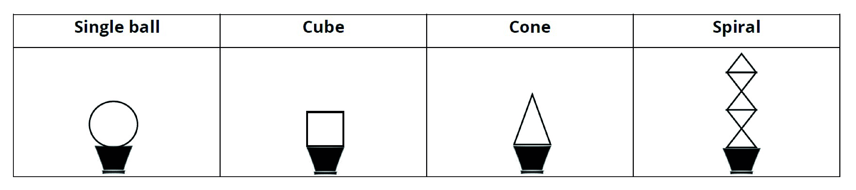
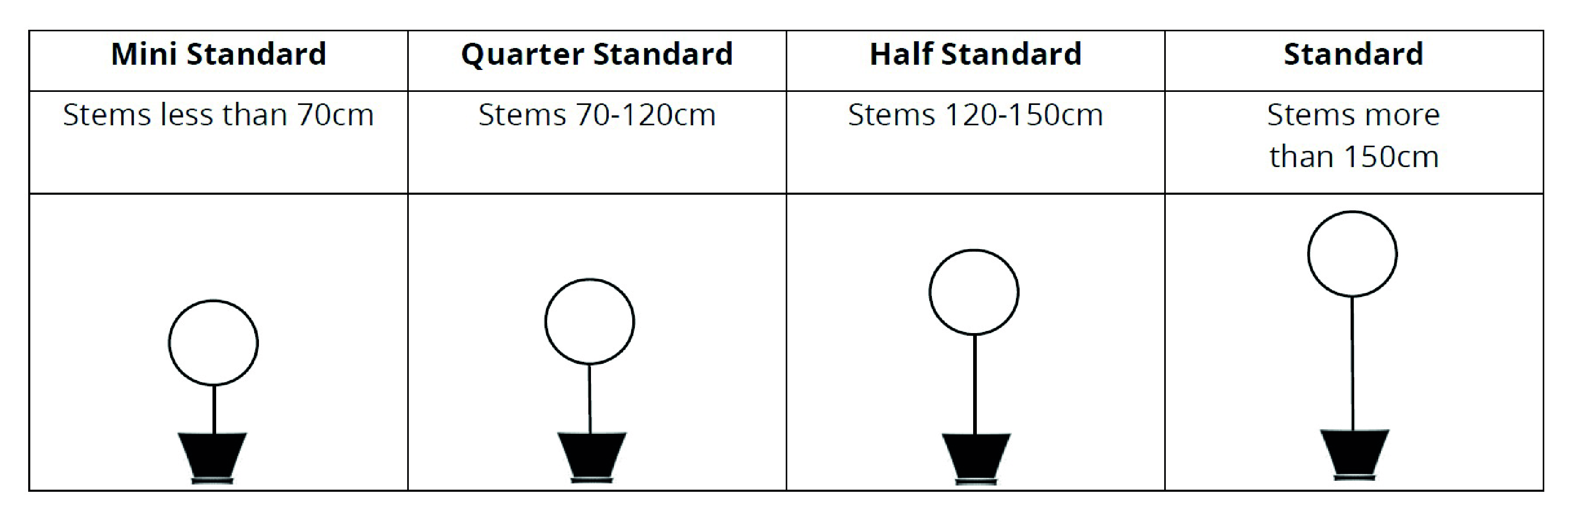
Types – some examples
20th February 2019

Slide 24
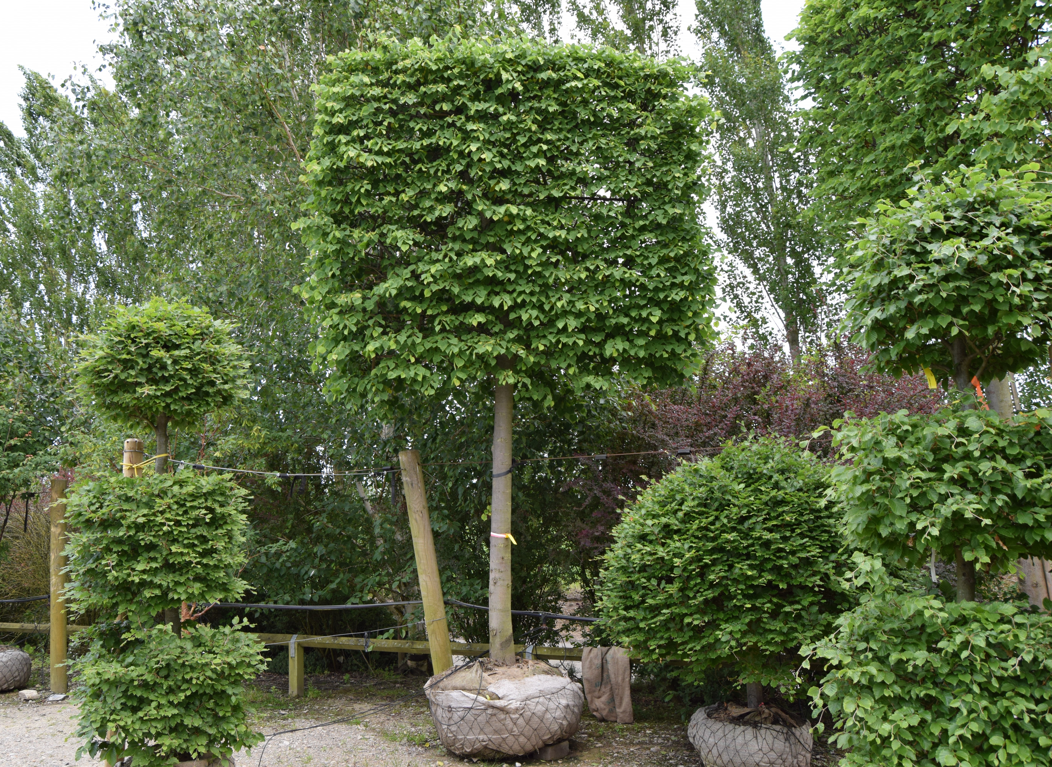
Clear Communication
20th February 2019

Slide 25
A Horticultural Jargon Buster
Session 4 – Walkabout
www.palmstead.co.uk
20th February 2019

Slide 26
A Horticultural Jargon Buster
Session 5 – Specifications
www.palmstead.co.uk
20th February 2019

Slide 27
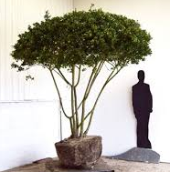
Specifications
A definition
- identifying something precisely or of stating a precise requirement, a detailed description of the design and materials
Terms & Jargon typical used in specifications;
  Name
  Type
  Number
  Size
  Form
  Root ball/container size (restricted access)
  A picture speaks a 1000 words – a review of our web site www.palmstead.co.uk
  How –high -wide -many stems -much headroom ………………………
20th February 2019

Slide 28
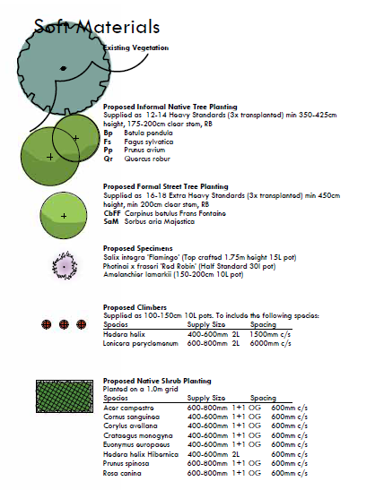
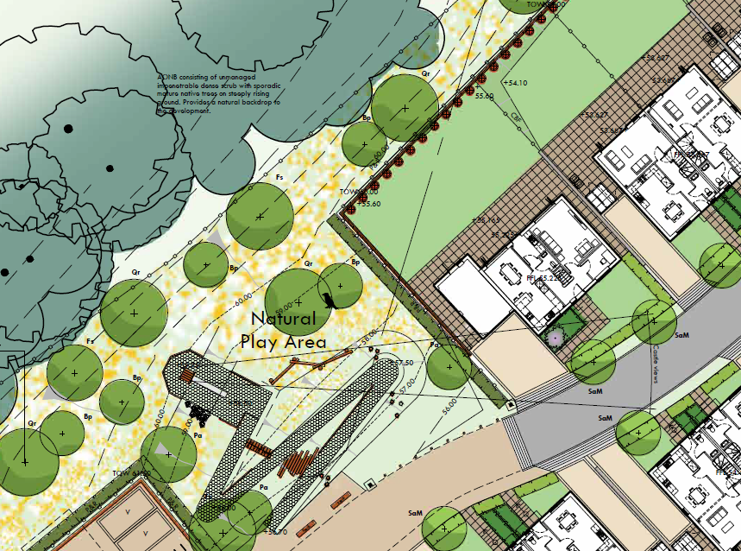
Specification – PDF
Often it is the missing information that causes the problems and delays – in this case quantities.
It is understanding the terminology and what to expect that fills in the gaps
20th February 2019

Slide 29
Specification – in excel
Hedges | Type | Number | Size | Form
Lonicera pileata | Regular | 655 | 40-60 | 10L
Pittosporum tenn. Irene Patterson | Regular | 1071 | 30-40 | 10L
Prunus laur. Otto Luyken | Regular | 735 | 60-80 | 10L
POS Shrubs Mix 1 | Type | Number | Size | Form
Cornus alba Elegantissima | Regular | 192 | 40-60 | 5L
Cornus stolonifera | Regular | 192 | 40-60 | 5L
Cornus sang. Midwinter Fire | Regular | 128 | 40-60 | 5L
Osmanthus x burkwoodii | Regular | 192 | 40-60 | 5L
Symphoricarpus x chen. Hancock | Regular | 192 | 40-60 | 5L
Viburnum davidii | Regular | 192 | 40-60 | 5L
Viburnum burkwoodii | Regular | 192 | 40-60 | 5L
POS Shrubs Mix 2 | Type | Number | Size | Form
Euonymus for. Emerald Gaiety | Regular | 354 | 60-80 | 5L
Hebe albicans | Regular | 354 | 60-80 | 5L
Hebe Autumn Glory | Regular | 354 | 60-80 | 5L
Hypericum hidcote | Regular | 177 | 60-80 | 5L
Ruscus aculeatus | Regular | 177 | 60-80 | 5L
Skimmia jap. Nymans | Regular | 177 | 60-80 | 5L
Viburnum opulus Compactum | Regular | 177 | 60-80 | 5L
Shrubs | Type | Number | Size | Form
Amelanchier lamarkii | Regular | 6 | 100-125 | 10L
Berberis thun. Atropurpure | Regular | 201 | 30-40 | 5L
Ceanothus Blue Mound | Regular | 107 | 40-60 | 5L
Choisya ternata | Regular | 92 | 40-60 | 5L
Cistus Silver Pink | Regular | 202 | 40-60 | 5L
Cornus alba Elegantissima | Regular | 12 | 80-100 | 10L
Cornus sang. Midwinter Fire | Regular | 65 | 40-60 | 5L
Cornus stol. Flaviramea | Regular | 77 | 40-60 | 5L
Euonymus euro. Red Cascade | Regular | 18 | 80-100 | 10L
Euonymus for. Emerald Gaiety | Regular | 197 | 30-40 | 5L
Euonymus for. Emerlad n Gold | Regular | 186 | 30-40 | 5L
Hebe Autumn Glory | Regular | 114 | 40-60 | 5L
Documents sent in Microsoft excel allows the transfer of information rapidly when we need to talk to others
If the planting date is known the form may include OG / RB for planting
November – March
On occasion specifications need to be challenged, in this case ‘dragging & dropping’ in excel returns sizes that may not be relevant to the pot size
20th February 2019

Slide 30

The Jargon Buster A-Z
An introduction to the Jargon we use
Our most up-to date version can be found at
www.palmstead.co.uk
We will update our Jargon Buster at the end of each mini workshop with
further terms. Look out for updates at the end of the month
20th February 2019

Slide 31
A Horticultural Jargon Buster
Session 6 – Meet the Team Q & A
www.palmstead.co.uk
20th February 2019

Slide 32
Thank you
A Horticultural Jargon Buster
What next?
'From seeds to specimen’
what size suits you best?
20th March 2019
www.palmstead.co.uk
20th February 2019

Slide 33
From seeds to specimens
20th March 2019
Building on this session we will cover some of the following
  From seed to specimens what suits you best
  Inside the factory
  Time lines, balancing budgets and expectations
  Maintaining integrity of the design and the essence of the scheme
  Contract grows V responsive supplies
  Stakeholders – meeting and balancing demand working in partnership
www.palmstead.co.uk
20th February 2019

